Slide 1
Data Structures and Algorithms -3 (25CS2103E)
CareTree – Advanced Algorithm-Based Hospital Care Management System
Team Members :
M. Ramya Sree : 2520030094
S. Lohitha : 2520030109
D. Teja Sadwika : 2520030536
Under the Esteemed Guidance of
Dr. Swathi – Professor,
Department of Computer Science & Engineering

Slide 2
Contents
Abstract
Introduction
Literature survey
Problem Statement and Objectives
Hardware and Software requirements
Results
Conclusion
Future Scope

Slide 3
Abstract
CareTree is a web-based Hospital Care Management System designed to simplify and organise essential hospital operations through a single platform. The system integrates patient management, doctor scheduling, appointment booking, bed and ward management, emergency dispatch, inventory management, pharmacy and laboratory services, and billing. It incorporates advanced algorithmic techniques such as string matching, dynamic programming, network flow, approximation algorithms, and randomised algorithms to demonstrate efficient searching, appointment scheduling, resource allocation, and monitoring-station placement. The project aims to reduce manual effort, improve information accessibility, and support better coordination of hospital resources. CareTree provides a practical application of advanced algorithms in healthcare management while offering opportunities for future improvements in automation, scalability, and real-time data processing.

Slide 4
Introduction
CareTree is a web-based Hospital Care Management System developed to manage and organise hospital activities efficiently through a single platform. It provides features for managing patient records, doctors, appointments, hospital beds, wards, emergency services, inventory, pharmacy, laboratory services, and billing. The system incorporates advanced algorithms such as string matching, dynamic programming, network flow, approximation, and randomised algorithms to demonstrate efficient searching, appointment scheduling, and resource allocation. CareTree aims to simplify hospital operations, reduce manual workload, improve coordination, and support effective utilisation of hospital resources. It also provides a practical way to understand how advanced algorithms can be applied to real-world healthcare management problems.

Slide 5
Literature Survey
The CareTree project is based on existing research and standard textbooks on algorithm design, optimisation, and healthcare management systems.
1. Introduction to Algorithms (CLRS): Provides the foundation for string matching, dynamic programming, network flow, and randomised algorithms used to demonstrate efficient searching and resource allocation.
2. Algorithm Design by Kleinberg and Tardos: Explains optimisation techniques, scheduling, network flow, and approximation algorithms that can be applied to appointment scheduling and hospital resource management.
3. Algorithms by Jeff Erickson: Provides clear explanations of algorithm design, correctness, and computational complexity, supporting the implementation of advanced algorithms in CareTree.
4. Existing Hospital Management Systems: Commonly provide patient registration, appointment booking, bed allocation, pharmacy, laboratory, and billing features. CareTree brings these operations together and demonstrates how advanced algorithms can support scheduling and resource planning.
Research gap: CareTree connects hospital management functions with practical demonstrations of advanced algorithms, providing a platform to explore efficient searching, scheduling, and resource allocation.

Slide 6
Problem Statement and Objectives
Hospital operations often involve managing large amounts of patient information, doctor schedules, appointments, bed availability, emergency services, inventory, and billing. Handling these activities separately can lead to delays, scheduling conflicts, difficulty tracking resources, and increased manual effort. CareTree aims to integrate these essential hospital activities into a single web-based platform and demonstrate the use of advanced algorithms for efficient searching, appointment scheduling, and resource allocation.
Objectives
Centralised Management: Maintain patient, doctor, appointment, and hospital service information in one platform.
Bed and Ward Management: Monitor bed availability and occupancy status.
Appointment Scheduling: Manage appointments and identify scheduling conflicts.
Emergency Management: Organise emergency dispatch information.
Resource Allocation: Demonstrate algorithms for efficient assignment and utilisation of hospital resources.
Inventory and Billing: Manage medical inventory, pharmacy, laboratory services, and billing records.
Algorithm Integration: Apply string matching, dynamic programming, network flow, approximation, and randomised algorithms to relevant hospital management tasks.

Slide 7
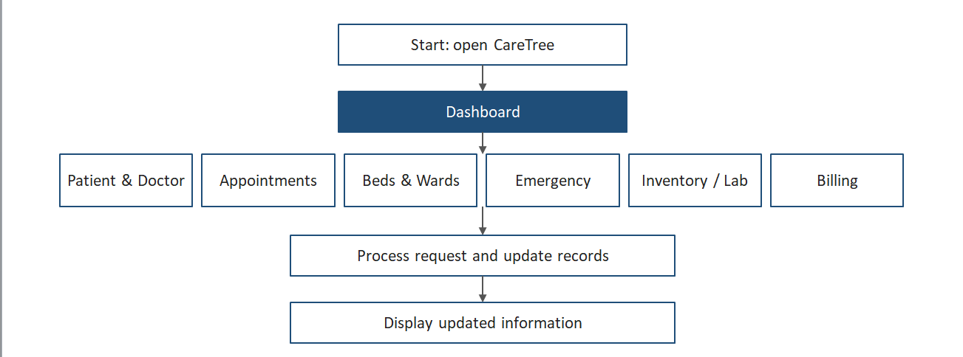
Flow Chart

Slide 8
Results
The CareTree Hospital Care Management System provides a unified interface for managing essential hospital operations. The system includes patient and doctor management, appointment scheduling, bed and ward monitoring, emergency dispatch, inventory management, pharmacy and laboratory services, and billing.
Centralised Dashboard: Displays important hospital information in one place.
Patient and Doctor Management: Supports organising and accessing patient and doctor records.
Appointment Scheduling: Helps identify scheduling conflicts and prioritise appointments.
Bed and Ward Monitoring: Displays bed availability and occupancy information.
Resource Management: Demonstrates advanced algorithms for searching, scheduling, and resource allocation.
Integrated Hospital Services: Organises emergency, inventory, pharmacy, laboratory, and billing operations.
Overall result: CareTree demonstrates how a single web-based platform can organise hospital workflows and apply advanced algorithms to healthcare management problems.

Slide 9
Hardware and Software requirements
1. Hardware Requirements
Processor: Intel Core i3 or equivalent and above.
RAM: Minimum 4 GB; 8 GB recommended.
Hard Disk: Minimum 500 MB of free space for project files and data.
Input Devices: Keyboard and mouse.
Output Device: Monitor or laptop display.
Network: Internet connection for accessing the website and external resources, if required.
2. Software Requirements
Operating System: Windows 10/11, Linux, or macOS.
Frontend Technologies: HTML, CSS, and JavaScript.
Development Environment: Visual Studio Code.
Web Browser: Google Chrome, Microsoft Edge, or Mozilla Firefox.
Data Storage: Browser Local Storage for prototype data.
Libraries: JavaScript libraries used by the project, such as Chart.js if included.
These requirements support the development and execution of CareTree, a web-based hospital care management system that demonstrates advanced algorithms for searching, scheduling, and resource management.

Slide 10
Conclusion
CareTree is a web-based Hospital Care Management System designed to simplify and organise essential hospital operations through a unified platform. It integrates patient and doctor management, appointment scheduling, bed and ward monitoring, emergency dispatch, inventory, pharmacy, laboratory services, and billing. The project demonstrates the practical application of advanced algorithms, including string matching, dynamic programming, network flow, approximation, and randomised algorithms, to searching, scheduling, and resource allocation problems. Overall, CareTree provides a foundation for improving hospital workflow organisation, reducing manual effort, and supporting efficient resource management. In the future, the system can be enhanced with real-time updates, secure database integration, and automated decision-support features.

Slide 11
Future Scope
Real-Time Updates: Integrate real-time bed availability, patient status, and inventory updates.
AI Integration: Introduce AI-based decision support for patient prioritisation and resource planning, with appropriate clinical validation.
Advanced Scheduling: Improve appointment scheduling and bed allocation using advanced optimisation algorithms.
Secure Database: Integrate a centralised database with authentication, role-based access, and data encryption.
Mobile Application: Develop a mobile-friendly application for doctors, nurses, administrators, and patients.
Automated Notifications: Send alerts for appointments, emergencies, low inventory, and billing reminders.
Data Analytics: Generate reports on bed occupancy, appointment trends, resource usage, and hospital operations.
Overall : CareTree can be extended into a more secure, intelligent, and scalable hospital management platform that supports efficient healthcare operations.

Slide 12
Thank you

